Slide 1
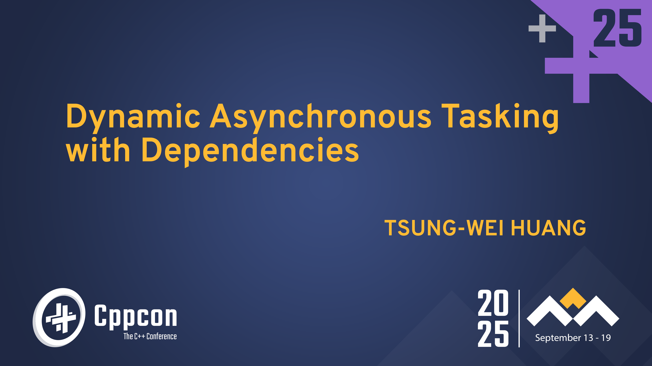
Notes:
Hello, everybody. My name is Tsung-Wei Huang, and you can just call me TW. Today, I am going to talk about Dynamic Asynchronous Tasking with Dependencies. This is a talk to help you parallelize your applications.

Slide 2
Takeaways
Understand the importance of asynchronous tasking with dependencies
Recognize the limitations of existing asynchronous tasking models
Introduce a new dynamic task graph programming model called AsyncTask
Overcome the scheduling challenges to support the model
Demonstrate the efficiency of AsyncTask
Conclude the talk
Notes:
This is what I am going to do for today’s talk.
We are going to understand the importance of asynchronous tasking with dependencies, and recognize the limitations of existing asynchronous tasking models.
Then, we will introduce a new dynamic task graph programming model called AsyncTask and overcome the scheduling challenges to support our model.
Finally, we will demonstrate the efficiency of our model and conclude the talk.

Slide 3
Why Parallel Computing?
Advances performance to a new level previously out of reach
10-100x speed-up over manycore CPUs and GPU
Notes:
You probably already know, parallel computing has advanced many of our application performance to a new level that is previously out of reach.
For example, if you want to train a machine learning model, with 40 CPUs, you can get 10x speed-up. With one GPU, you can bring another 10x speed-up.

Slide 4


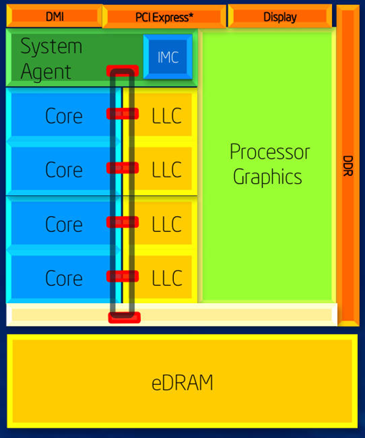
Modern Hardware is Designed to Run in Parallel
Intel Haswell microarchitecture
Released in June 2013
Typically comes with four cores
Has an integrated GPU
1.4 B transistors with 22 nm technology
Sophisticated design for ILP acceleration
Deep pipeline – 16 stages
Superscalar architecture
Can issue and complete multiple independent instructions per cycle
Supports hyper-threading tech (HTT)
Allows a single physical CPU core to appear as two logical processors to the OS
If you don’t do parallel programming, you are not utilizing your hardware efficiently …
Notes:
More importantly, modern hardware has been designed to run in parallel for performance.
For example, here I am showing you an example of the Intel Haswell microarchitecture, which is released in 2013. This architecture typically comes with four cores and has an integrated GPU.
It is based on the superscalar architecture that can issue and complete multiple independent instructions per cycle. It also supports hyper-threading technology that allows a single physical CPU core to appear as two logical processors to the operating system.
(click) So, if you don’t do parallel programming, you are not utilizing your hardware efficiently.

Slide 5
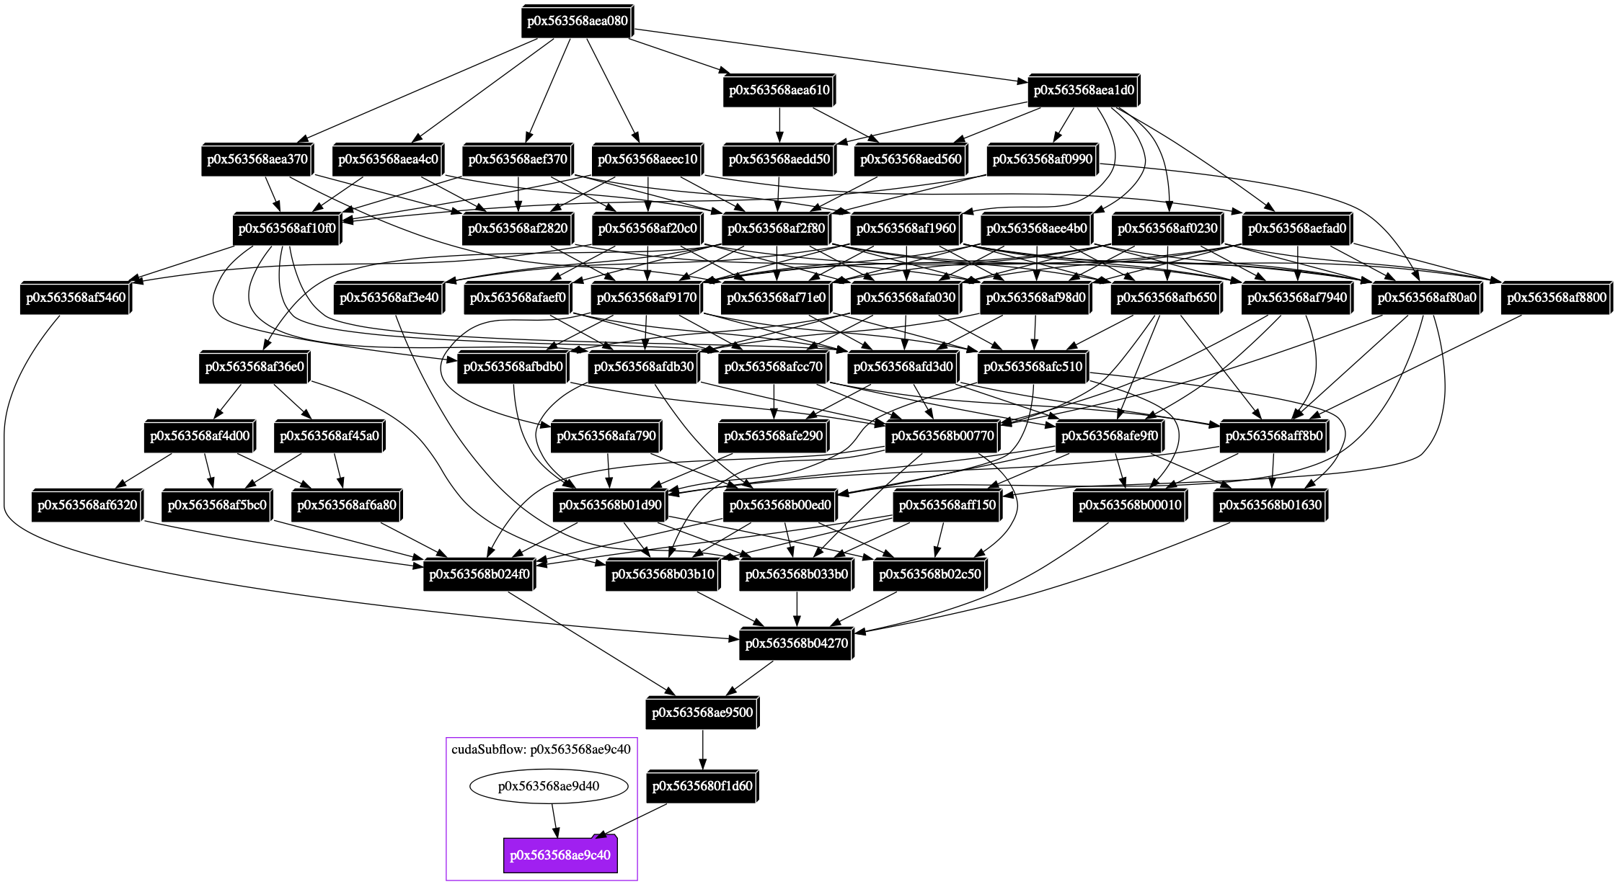
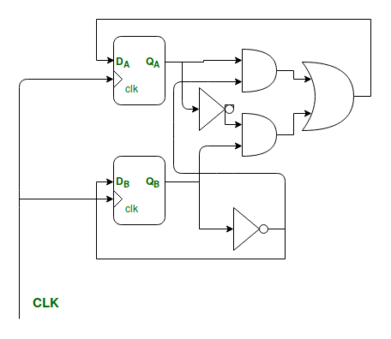

Today’s Parallel Computing Problem is Very Irregular
Computational task graph of a GPU-parallel circuit simulation workload¹
> 500M gates and nets
> 1000 async kernel tasks
> 1000 dependencies
> hours to finish
Simulation task graph
…
Deep learning accelerator
¹: Dian-Lun Lin, et al, “From RTL to CUDA: A GPU Acceleration Flow for RTL Simulation with Batch Stimulus,” ACM ICPP, 2022
Notes:
However, today’s parallel computing problems are very complicated and irregular. Here, I am showing you a computational task graph of a GPU-accelerated circuit simulation workload.
The task graph models a GPU operation as an asynchronous task and a dependency between two GPU operations in an edge.
This computational task graph can be very large. In this example where we simulate an Nvidia deep learning accelerator design of 500M gates, it has more than 1000 asynchronous kernel tasks and dependencies. Even with GPU, it still takes hours to finish.

Slide 6
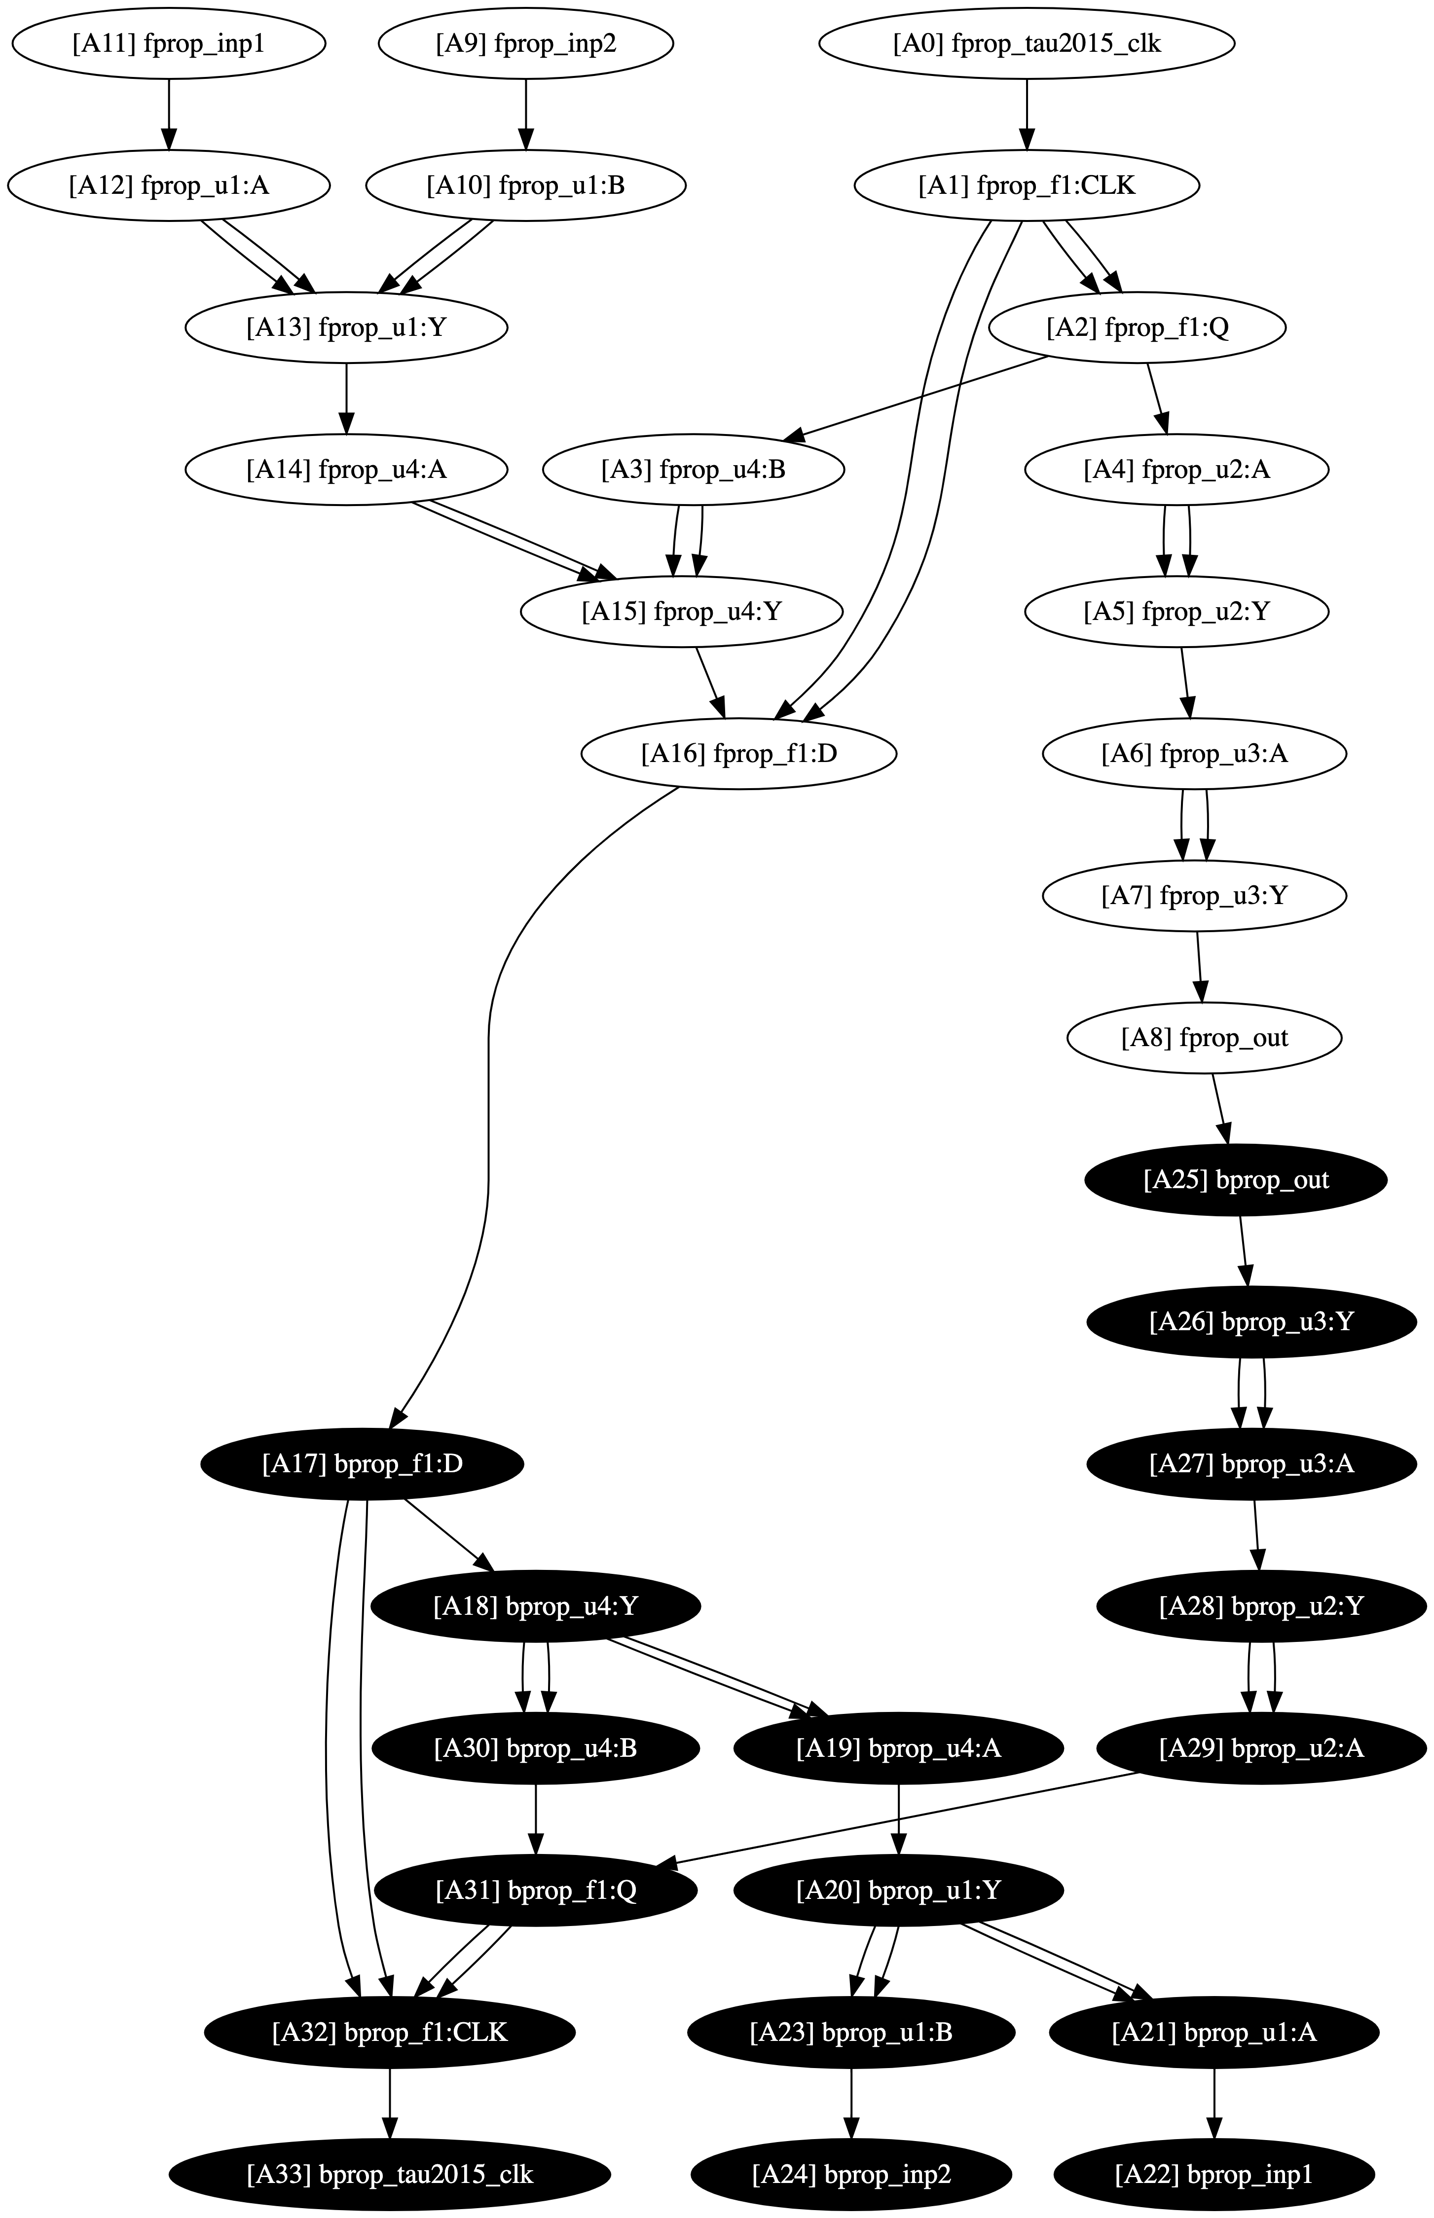
Another Example of Irregular Parallel Workload
CPU-parallel VLSI static timing analysis algorithm
Analysis algorithm is modeled as a task graph
> 100M async tasks
> 150M dependencies
¹: Tsung-Wei Huang, et al, “OpenTimer v2: A New Parallel Incremental Timing Analysis Engine,” IEEE TCAD, 2022
Notes:
This is another example of irregular parallel computing problem where we parallelize the VLSI circuit timing analysis using manycore CPUs. The analysis algorithm is modeled as a task graph that propagates the timing values from the inputs of a circuit to its output.
For large design, the resulting task graph can contain more than 100 M async tasks and 150 M task dependencies.

Slide 7
Parallelizing such Irregular Problems is Not Easy …
You need to deal with A LOT OF technical details
Parallelism abstraction (software + hardware)
Concurrency control
Synchronization
Task and data race avoidance
Dependency constraints
Scheduling efficiencies (load balancing)
Programming productivity
Performance portability
…
And, don’t forget about trade-offs
Performance vs Developer’s intent
Performance?
Intent
Portable
Extensible
Maintainable
Trade-offs
Simple
We want a solution that can sit on top to help programmers manage these details as much as possible because programmers care how fast (performance + productivity) they can get things done!
Notes:
It turns out parallelizing this type of irregular problem is not easy, because you need to deal with a lot of technical details, such as parallelism abstraction, like abstraction, concurrency control, scheduling efficiencies, and so on so forth.
And… there is always this tradeoff between what you want and the cost of that intent. For example, you want simple, maintainable, extensible, and portable implementation, but each of them can come at the cost of performance.
(click) So, we want a solution that can sit on top to help programmers manage as much these details as possible because they care how fast they can get things done! By fast, I mean both performance and productivity.

Slide 8
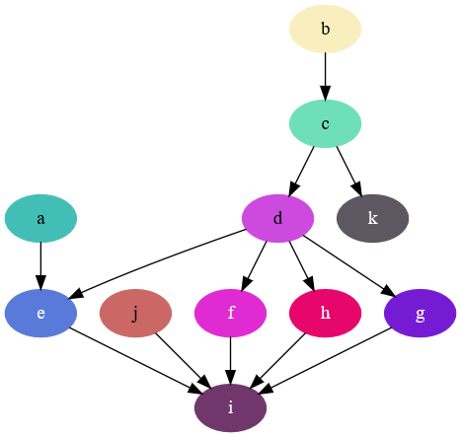





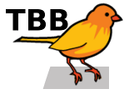

Why Task-parallel Programming (TPP)?
TPP is an effective solution for parallelizing irregular workloads
Captures developers’ intention in decomposing an algorithm into a top-down task graph
Delegates difficult scheduling details (e.g., load balancing) to an optimized runtime
Modern parallel programming libraries are moving towards task parallelism
OpenMP 4.0 task dependency clauses (omp depend)
C++26 execution control library (std::exec)
TBB flow graph (tbb::flow::graph)
Taskflow control Taskflow graph (CTFG) model
… (many others)
Task graph encapsulates functions as tasks and their dependencies as edges.
Task
dependency
Notes:
Among various solutions, task-parallel programming or TPP has shown promise to be an effective solution particularly for irregular workloads, because it (1) captures developers’ intention in decomposing an algorithm into a top-down task graph (2) while delegating difficult scheduling details (like load balancing and concurrency control) to an optimized runtime.
That is why over the past few years we are seeing a growing number of parallel programming libraries moving toward task parallelism, such as OpenMP’s task dependency clauses, C++26 execution control, TBB flowgraph, and Taskflow.

Slide 9
Takeaways
Understand the importance of asynchronous tasking with dependencies
Recognize the limitations of existing asynchronous tasking models
Introduce a new dynamic task graph programming model called AsyncTask
Overcome the scheduling challenges to support the model
Demonstrate the efficiency of AsyncTask
Conclude the talk
Notes:
Now we are going to look into some popular asynchronous tasking models and their limitations.

Slide 10
Create an Asynchronous Task using std::async¹
A high-level standard library facility to launch a task asynchronously
#include <future>
#include <iostream>
int compute(int v) {
return v;
}
int main() {
std::future<int> fu = std::async(std::launch::async, compute, 42);
std::cout << fu.get() << std::endl; // prints 42
}
Use std::async to asynchronously run the function compute(42) on a new thread.
Return a std::future to wait for this asynchronous task to finish and access its result (i.e., 42)
¹: C++ std::async interface: https://en.cppreference.com/w/cpp/thread/async.html
Notes:
In C++, we can create an asynchronous task using std::async, which is a high-level standard library facility to launch a task asynchronously.
For example, here I have a function “compute” that does nothing but returns its input argument.
(click) We use std::async to asynchronously run the function “compute” on a new thread.
(click) And that std::async will return a future object for us to wait for this asynchronous task to finish and access its result. In this case, it will be 42.
Very simple.

Slide 11
An Example Implementation of std::async
template <typename F, typename... Args>
auto async(F&& func, Args&&... args) {
using ReturnType = std::invoke_result_t<F, Args...>;
// promise-future pair for intern-thread sync
std::promise<ReturnType> prom;
std::future<ReturnType> fu = prom.get_future();
std::thread t([prom=std::move(prom),
f=std::forward<F>(func), ...args=std::forward<Args>(args)] () mutable {
if constexpr(std::is_void_v<ReturnType>) {
f(std::move(args)...);
prom.set_value();
} else {
prom.set_value(f(std::move(args)...));
}
});
t.detach(); // mimic fire-and-forget behavior of std::async
return fu;
}
I promise you that I will run your function, and you can access the result from the future object …
We create a thread from a lambda function object that captures the function and its argument (with perfect forwarding¹) and invoke the function in the body.
¹: C++ std::forward: https://en.cppreference.com/w/cpp/utility/forward.html
Notes:
This is an example implementation of std::async.
We have two templates, one on the function type and another on the argument types. First, we get the return type of the function and use it to create a promise-future pair for inter-thread synchronization.
Basically, I promise you I will run your function and you can access the result from the future object.
Next, we create a thread from a lambda that captures the function and its arguments, and invoke the function in the body.
Then, we detach the thread to mimic the fire-and-forget behavior of std::async.
Finally, we return the future to the caller.

Slide 12
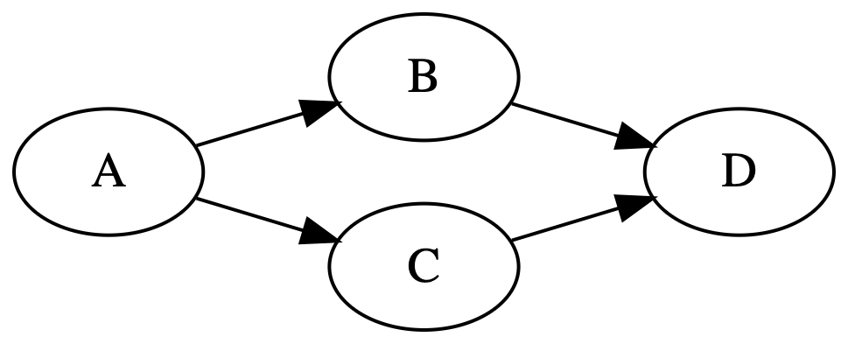
Build a Task Graph w/ std::async and std::future
std::future allows us to perform task-specific synchronization
auto A = std::async(std::launch::async,
[](){ std::cout << “A\n”; }
);
A.wait();
auto B = std::async(std::launch::async,
[](){ std::cout << “B\n”; }
);
auto C = std::async(std::launch::async,
[](){ std::cout << “C\n”; }
);
B.wait();
C.wait();
auto D = std::async(std::launch::async,
[](){ std::cout << “D\n”; }
);
D.wait();
We need to wait for A to finish before launching B and C asynchronously.
We need to wait for B and C to finish before launching D asynchronously
By properly synchronizing tasks using future.wait, we can dynamically create a task graph (i.e., dynamic task graph)
Notes:
With std::async and std::future, we can build a task graph to handle asynchronous tasking with dependencies. That is because std::future allows us to perform task-specific synchronization.
For example, suppose my task graph has four tasks, A, B, C, D, and four dependencies, A runs before B and C, D runs after B and C.
To ensure correct execution, we need to wait for A to finish before launching B and C asynchronously.
Similarly, before launching D asynchronously, we need to wait for B and C to finish.
(click) As a result, by properly synchronizing tasks using future.wait, we can create a task graph dynamically.

Slide 13
Sender-Receiver Version (with std::exec¹)
A standardized abstraction for composing tasks and dependencies
Schedule tasks on a pool of worker threads
exec::static_thread_pool pool;
auto scheduler = pool.get_scheduler();
// create a sender task for A
auto sa = exec::then(exec::schedule(scheduler), []{ std::cout<<"A\n"; });
exec::sync_wait(sa); // wait for A
// create two parallel sender tasks for B and C
auto sb = exec::then(exec::schedule(scheduler), []{ std::cout<<"B\n"; });
auto sc = exec::then(exec::schedule(scheduler), []{ std::cout<<"C\n"; });
exec::sync_wait(exec::when_all(sb, sc)); // wait for B and C
// create a sender task for D
auto sd = exec::then(exec::schedule(scheduler), []{ std::cout<<"D\n"; });
exec::sync_wait(sd); // wait for D
¹: C++ execution control library (experimental): https://en.cppreference.com/w/cpp/experimental/execution.html
Notes:
Let’s take a look the same task graph but implemented using the C++ sender-receiver model, which is a standardized abstraction for composing tasks and dependencies.
Here, we use a static_thread_pool to schedule tasks on a pool of worker threads.
We create a sender task for A and synchronize its execution before launching two parallel sender tasks, B and C.
Then, we use when_all to wait for both B and C to complete before creating the final sender task, D.
Finally, we synchronize once more to complete the task graph.

Slide 14
Intel’s TBB Library with tbb::task_group¹
A class to create asynchronous tasks and wait for their completion
A class in TBB to create asynchronous tasks and wait for their completion
tbb::task_group tg;
// A
tg.run([] { std::cout << "A\n"; });
tg.wait();
// B and C in parallel
tg.run([] { std::cout << "B\n"; });
tg.run([] { std::cout << "C\n"; });
tg.wait();
// D
tg.run([] { std::cout << "D\n"; });
tg.wait();
Need to task_group::wait on A before running B and C
Need to task_group::wait on B and C before running D
¹: TBB task group: https://oneapi-spec.uxlfoundation.org/specifications/oneapi/v1.3-rev-1/elements/onetbb/source/task_scheduler/task_group/task_group_cls
Notes:
This slide shows the same graph but implemented using TBB library with task_group, which is a class to create asynchronous tasks and wait for their competition.
First, we create a task group tg, and use the run method to create four asynchronous tasks A, B, C, and D.
Similarly, we need to wait on A before running B and C, and wait in B and C before launching D.

Slide 15
OpenMP Tasking Model with depend Clauses¹
Leverages compiler directives to define tasks and dependencies
#omp parallel
{
int A_B, A_C, B_D, C_D;
#pragma omp task depend(out: A_B, A_C)
std::cout << “TaskA\n”;
#pragma omp task depend(in: A_B; out: B_D)
std::cout << “TaskB\n”;
#pragma omp task depend(in: A_C; out: C_D)
std::cout << “TaskB\n”;
#pragma omp task depend(in: B_D, C_D)
std::cout << “TaskB\n”;
}
Define dependency handles
Specify task dependencies using in and out clauses when creating an OpenMP task
A_B
B_D
A_C
C_D
With these OpenMP directives, the compiler will insert parallel code that launches asynchronous tasks and enforces their dependencies.
¹: OpenMP task dependency clauses (version 5, 2008): https://www.openmp.org/spec-html/5.0/openmpsu99.html
Notes:
Again, this slide implements the same task graph but using OpenMP’s task dependency clauses, which leverages compiler directives to define tasks and dependencies for parallel execution.
Inside the OpenMP parallel region, we define dependency handles in four integers, A_B, A_C, B_D, and C_D that represent the task dependencies from A to B, A to C, B to D, and C to D, respectively.
Then, we specify the task dependencies using “in” and “out” clauses when creating an OpenMP task. For example, task A has two outgoing dependencies on B and C; task D has two incoming dependencies on B and C.
(click) With these OpenMP directives, the compiler will insert parallel code that launches asynchronous tasks and enforces their dependencies.

Slide 16
OpenCilk Version
A fork-join programming model relying on compiler-generated parallel code
With language extensions like cilk_spawn and cilk_sync
void A() { std::cout << "A\n"; }
void B() { std::cout << "B\n"; }
void C() { std::cout << "C\n"; }
void D() { std::cout << "D\n"; }
int main() {
A();
cilk_spawn B();
C();
cilk_sync;
D();
}
You need a compiler that supports OpenCilk syntax to run this code.
Spawn a child task on B using cilk_spawn and continue with C in the main thread
Synchronize both B and C using cilk_sync before running task D
¹: OpenCilk: https://www.opencilk.org/
Notes:
Finally, this slide shows the implementation using OpenCilk, which is a fork-join programming model that relies on compiler-generated parallel code using keywords like cilk_spawn and cilk_sync.
In this example, after running task A, we spawn a child task on B using cilk_spawn, continue with C in the main thread, and then synchronize both B and C using cilk_sync before running task D.
(click) Similar to OpenMP, you need a compiler that supports OpenCilk syntax to run this code.

Slide 17
Limitations of Existing Async Tasking Models
Tasks and their dependencies are decoupled during task graph creation
If dependencies are not expressed alongside the task creation logic, it’s difficult to reason about the overall task graph structure
Without a clear dependency structure, the runtime loses opportunities to optimize task placement and load balancing when constructing an asynchronous task
Correct placement of wait calls is left to programmers
Programmers must determine a correct synchronization order at a fine-grained level
In the worst case, the number of waits equals the number of dependencies
In practice, many applications only care about the completion of the entire task graph instead of intermediate tasks, making such fine-grained waiting unnecessary, costly, and buggy
Limited support for building highly dynamic task graphs
Highly dynamic task graphs → those whose structures, dependencies, and task content are highly dependent on runtime variables or dynamic control-flow results
Ex: OpenMP is not a good fit for this scenario as it relies on static compiler directives
May require a non-standard C++ compiler to generate parallel code
Notes:
So far, we have seen many different asynchronous tasking models to create task graph dynamically. While each has its own advantages in certain domains, they frequently come with the following limitations that prevent us from fully utilizing the potential of dynamic task graph parallelism.
First of all, if you pay attention to these models that we just talked about, tasks and their dependencies are decoupled during the task graph construction. (explain)
Second, correct placement of wait calls is left to programmers. (explain)
Third, existing models have very limited support for building task graphs in a highly dynamic environment, such as those whose structure, dependencies, task content are highly dependent on runtime variables or dynamic control-flow results. (explain)
Finally, some models may require a non-standard C++ compiler to generate parallel code, such as OpenMP and OpenCilk, which can have portability issues across different platforms.

Slide 18
Takeaways
Understand the importance of asynchronous tasking with dependencies
Recognize the limitations of existing asynchronous tasking models
Introduce a new dynamic task graph programming model called AsyncTask
Overcome the scheduling challenges to support the model
Demonstrate the efficiency of AsyncTask
Conclude the talk
Notes:
Now, I am going to introduce a new dynamic task graph programming model called AsyncTask to address these limitations.

Slide 19
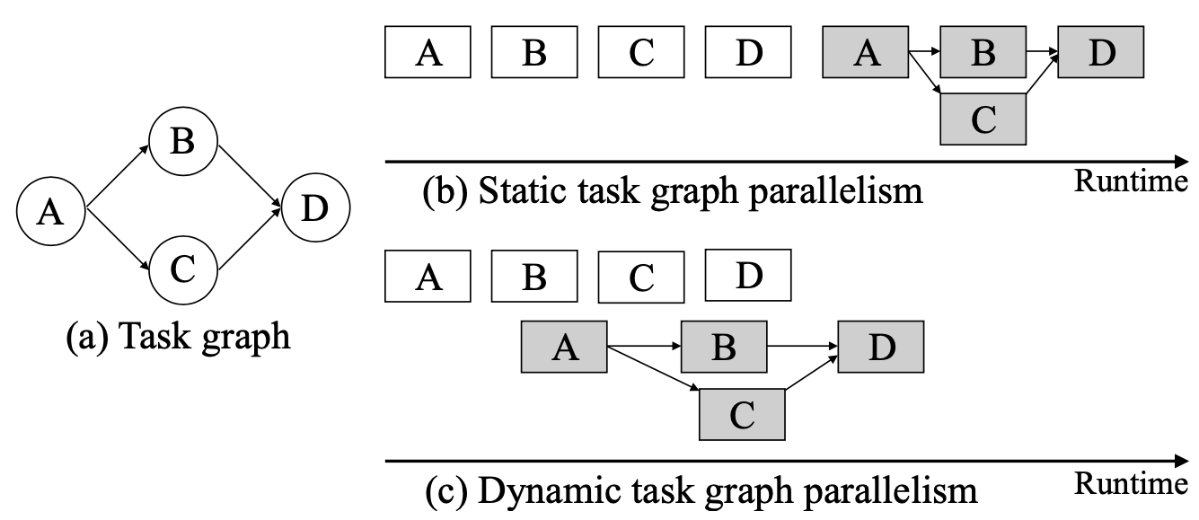
Static vs Dynamic Task Graph Programming (TGP)
All examples we’ve discussed so far are dynamic TGP (DTGP)
In static TGP (STGP), execution follows the construct-and-run model
t
STGP
Task construction
Task execution
Saved time
DTGP
t
In DTGP, tasks can start as soon as their dependencies are met
Task construction
Task execution
Notes:
Before I talk about dynamic task graph programming, let’s first understand the difference between static and dynamic task graph programming (TGP).
All the examples we have discussed so far fall are dynamic task graph programming (DTGP). In static task graph programming (STGP), execution follows a construct-and-run model: you build the task graph first and then run it.
On the other hand, in DTGP, tasks can start as soon as their dependencies are met, meaning that construction and execution can overlap. For large graphs, this overlap can provide some performance advantages over STGP.

Slide 20
Static Task Graph Programming in Taskflow¹
#include <taskflow/taskflow.hpp> // Live: https://godbolt.org/z/j8hx3xnnx
int main(){
tf::Taskflow taskflow;
tf::Executor executor;
auto [A, B, C, D] = taskflow.emplace(
[] () { std::cout << "TaskA\n"; }
[] () { std::cout << "TaskB\n"; },
[] () { std::cout << "TaskC\n"; },
[] () { std::cout << "TaskD\n"; }
);
A.precede(B, C);
D.succeed(B, C);
executor.run(taskflow).wait();
return 0;
}
STGP
t
Task construction
Task execution
¹: T.-W. Huang, et. al, “Taskflow: A Lightweight Parallel and Heterogeneous Task Graph Computing System,” IEEE TPDS, 2022
Notes:
To better understand this difference, let’s take a look at static task graph programming in Taskflow, which is a C++ library for task-parallel programming.
Suppose our task graph has four tasks, A, B, C, and D, A runs before B and C, and D runs after B and C.
In STGP, you define this graph in a Taskflow object. For example, you define four tasks in terms of C++ lambda function objects, A, B, C, and D, and use the precede and succeed method to relate the dependencies among A, B, C, D. When the graph is constructed, you submit it to an executor for execution.
As you can see, the construction and execution of the task graph are separate from each other.

Slide 21
AsyncTask: Dynamic Task Graph Programming in Taskflow
// Live: https://godbolt.org/z/j76ThGbWK
tf::Executor executor;
auto A = executor.silent_dependent_async([](){
std::cout << "TaskA\n";
});
auto B = executor.silent_dependent_async([](){
std::cout << "TaskB\n";
}, A);
auto C = executor.silent_dependent_async([](){
std::cout << "TaskC\n";
}, A);
auto [D, Fu] = executor.dependent_async([](){
std::cout << "TaskD\n";
}, B, C);
Fu.wait();
Fu.wait();
t
Task construction
Task execution
Specify variable task dependencies using C++ variadic parameter pack
Notes:
Instead of starting from scratch, we have built our dynamic task graph programming model, AsyncTask, atop Taskflow so we can reuse many of its facilities.
Using the same graph as an example, we can create a task from a C++ lambda function object using the silent_dependent_async method or the dependent_async method to acquire an additional future object that allows you to access the result or perform fine-grained synchronization.
(click) When you create a dependent_async task, you can specify arbitrary dependencies using C++ variadic parameter pack. For example, when creating task D, I pass B and C as the last two arguments, indicating that D cannot start until both B and C finish.
(click) More importantly, when you create a dependent_async task, the runtime will start its execution immediately whenever its dependencies are met, so the task graph construction can overlap with task execution.

Slide 22
Wait for All Tasks to Finish
// Live: https://godbolt.org/z/T87PrTarx
tf::Executor executor;
auto A = executor.silent_dependent_async([](){
std::cout << "TaskA\n";
});
auto B = executor.silent_dependent_async([](){
std::cout << "TaskB\n";
}, A);
auto C = executor.silent_dependent_async([](){
std::cout << "TaskC\n";
}, A);
auto D = executor.silent_dependent_async([](){
std::cout << "TaskD\n";
}, B, C);
executor.wait_for_all();
wait_for_all
t
Task construction
Task execution
Wait for the entire graph to finish.
Notes:
If you don’t want fine-grained synchronization, like waiting for a particular task in the graph to finish using its future object, you can use the method, “wait_for_all”, to wait for the entire graph to finish.

Slide 23
Need a Correct Topological Order
auto A = executor.silent_dependent_async(
[](){ std::cout << "TaskA\n"; }
);
auto B = executor.silent_dependent_async(
[](){ std::cout << "TaskB\n"; }, A
);
auto C = executor.silent_dependent_async(
[](){ std::cout << "TaskC\n"; }, A
);
auto D = executor.silent_dependent_async(
[](){ std::cout << "TaskD\n"; }, B, C
);
Topological order #2: A→C→B→D
auto A = executor.silent_dependent_async(
[](){ std::cout << "TaskA\n"; }
);
auto C = executor.silent_dependent_async(
[](){ std::cout << "TaskC\n"; }, A
);
auto B = executor.silent_dependent_async(
[](){ std::cout << "TaskB\n"; }, A
);
auto D = executor.silent_dependent_async(
[](){ std::cout << "TaskD\n"; }, B, C
);
Topological order #1: A→B→C→D
Notes:
You probably already know, DTGP needs a correct topological order to specify dependencies dynamically. This is because when you define a dependency on a dynamic task, the parent task of the dependency must exist in a correct topological order.
In our example, this means we can program the dynamic task graph using ABCD or ACBD, because both are correct topological orders.

Slide 24
Incorrect Topological Order …
tf::Executor executor;
auto A = executor.silent_dependent_async([](){
std::cout << "TaskA\n";
});
auto D = executor.silent_dependent_async([](){
std::cout << "TaskD\n";
}, B-is-unavailable-yet, C-is-unavailable-yet);
auto B = executor.silent_dependent_async([](){
std::cout << "TaskB\n";
}, A);
auto C = executor.silent_dependent_async([](){
std::cout << "TaskC\n";
}, A);
executor.wait_for_all();
An incorrect topological order (A→D→B→C) prevents you from expressing a correct dynamic task graph.
Notes:
An incorrect topological order prevents you from expressing a correct dynamic task graph.
For example, if we create D before B and C, we cannot specify its dependencies because B and C do not exist yet.

Slide 25
Variable Range of Task Dependencies
Both methods can take a variable range of dependent-async tasks
Useful when the task dependencies come as a runtime variable (e.g., loaded from a file)
// Live: https://godbolt.org/z/6Pvco4KeE
std::vector<tf::AsyncTask> tasks = {
executor.silent_dependent_async([](){ std::cout << "TaskA\n"; }),
executor.silent_dependent_async([](){ std::cout << "TaskB\n"; }),
executor.silent_dependent_async([](){ std::cout << "TaskC\n"; }),
executor.silent_dependent_async([](){ std::cout << "TaskD\n"; })
};
// create a dependent-async tasks that depends on tasks, A, B, C, and D
executor.dependent_async([](){}, tasks.begin(), tasks.end());
// create a silent-dependent-async task that depends on tasks, A, B, C, and D
executor.silent_dependent_async([](){}, tasks.begin(), tasks.end());
While this feature may look trivial, I found it very difficult to achieve with existing asynchronous tasking libraries because their task creation and dependency expression are decoupled from each other …
Notes:
Both methods, silent_dependent_async and dependent_async, can take a variable range of dependent-async tasks. This is particularly useful when task dependencies are determined at runtime, such as when the graph structure is loaded from a file.
For example, we can create a vector of dependent async tasks and then use it to specify the dependencies when creating another task.
(click) While this feature may look trivial, (explain)...
For example, if your task graph comes as a runtime variable, it’s very difficult to do it with OpenMP and the C++ sender-receiver model.

Slide 26
DTGP is Flexible for Runtime-driven Execution
Assemble task graphs driven by runtime variables and control-flow results
if (a == true) {
G1 = build_task_graph1();
if (b == true) {
G2 = build_task_graph2();
G1.precede(G2);
if (c == true) {
… // defined other TGPs
}
}
else {
G3 = build_task_graph3();
G1.precede(G3);
}
}
G1 = build_task_graph1();
G2 = build_task_graph2();
if (G1.num_tasks() == 100) {
G1.precede(G2);
}
else {
G3 = build_task_graph3();
G1.precede(G2, G3);
if(G2.num_dependencies()>=10){
… // define another TGP
} else {
… // define another TGP
}
}
This type of dynamic task graph is very difficult to achieve using static task graph programming …
Notes:
One major advantage of DTGP is the flexibility for runtime-driven execution, meaning that you can flexibly assemble task graphs driven by runtime variables and dynamic control-flow results.
For example, depending on the values of the variables a b c, I can create a different task graph. If a is true, I create a task graph G1. If b is true, I create a task graph G2 that runs after G1; otherwise, I create a totally different task graph G3 and make it run after G1.
Or, if G1 has 100 tasks, I am going to run G2 right after G1. Otherwise, I will create a new task graph G3 and make G2 G3 run after G1.
(click) This type of dynamic task graph parallelism is very difficult to achieve using static task graph programming.

Slide 27
AsyncTask doesn’t Touch Data Abstraction
Focus on coarse-grained task parallelism not fine-grained data parallelism
Our goal is to have users describe tasks and their dependencies in an expressive language
Users describe func as a lambda and capture necessary data or func arguments themselves
The advantage of this decision is twofold:
Users retain full control over data layout and ownership, allowing them to optimize data structures and memory layout for their specific application domains
Letting users decide how and where to store data keeps AsyncTask lightweight and non-intrusive – no need to modify existing data structures to fit our framework
Ex: Models that count on data abstraction (e.g., Fastflow, TBB pipeline) require users to rewrite their code to library-specific data abstraction in order to gain parallelism
template <typename F, typename... Tasks>
auto dependent_async(F&& func, Tasks&&... tasks) {
...
}
This is how std::async is implemented
(e.g., args are captured with perfect forwarding)
Notes:
As you can see from our programming model, AsyncTask doesn't touch data abstraction.
This is a very important decision we made during the early-stage design of AsyncTask: we want to focus on coarse-grained task parallelism rather than fine-grained data parallelism. The primary goal is to let users describe tasks and their dependencies through a clean, expressive interface.
With this interface, users can define function as a lambda and capture the necessary data or arguments themselves. This is essentially how std::async is implemented,
The advantage of this decision is two fold: first, Users retain full control over data layout and ownership, allowing them to optimize data structures for their specific application domain.
Second, letting users manage their own data keeps AsyncTask lightweight and non-intrusive – there is no need to modify your data structures to fit our framework. This is different from models that count on data abstraction, such as fastflow and TBB’s pipeline programming mode, requiring users to rewrite their code to library-specific data abstraction in order to gain parallelism.

Slide 28
Takeaways
Understand the importance of asynchronous tasking with dependencies
Recognize the limitations of existing asynchronous tasking models
Introduce a new dynamic task graph programming model called AsyncTask
Overcome the scheduling challenges to support the model
Demonstrate the efficiency of AsyncTask
Conclude the talk
Notes:
Now, I am going to talk about how we overcome the scheduling challenges to support our programming model.

Slide 29
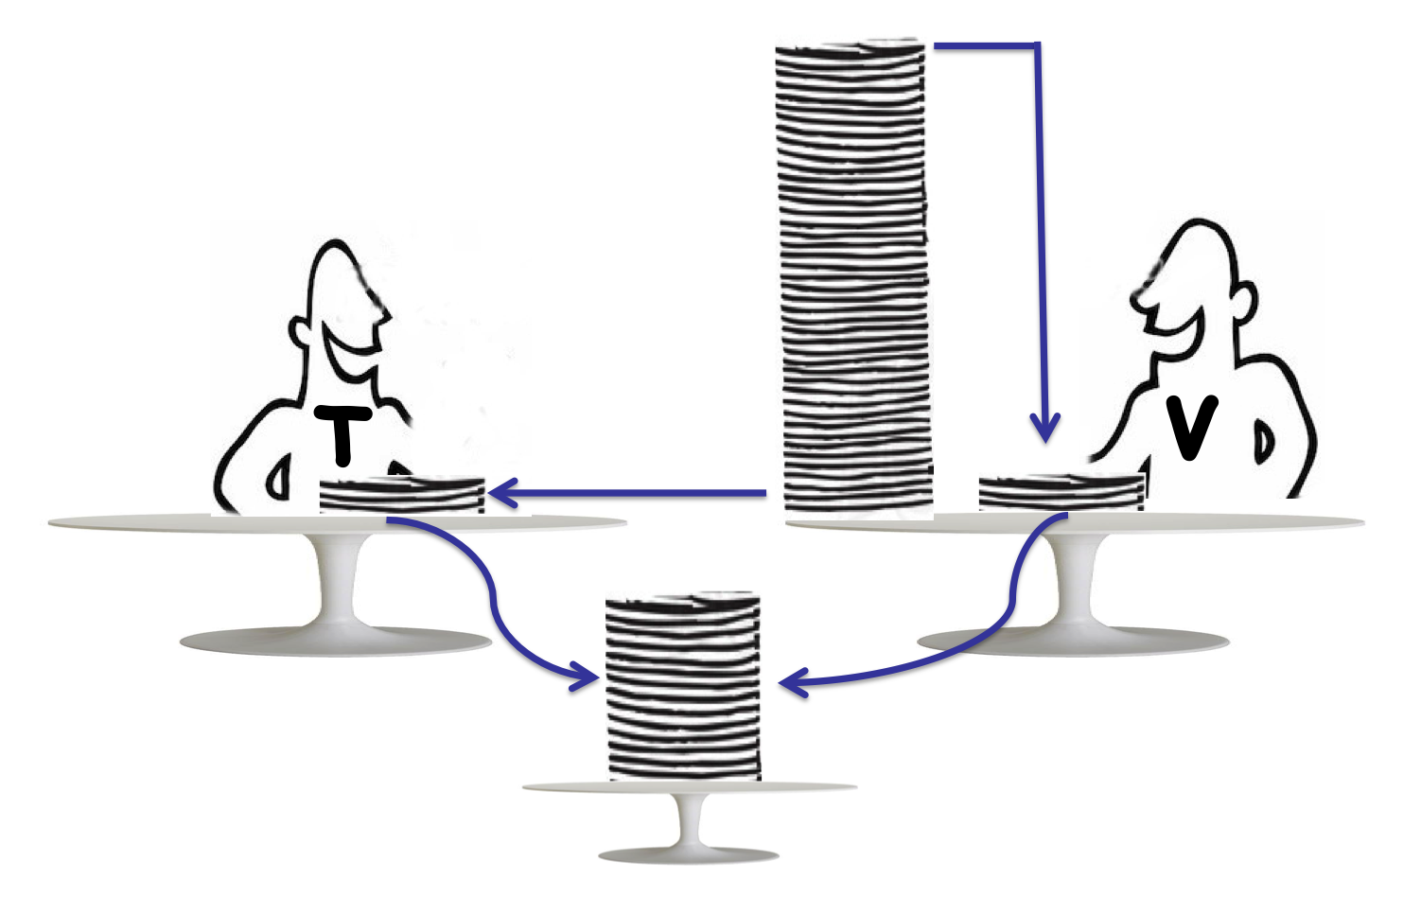
Overview: Taskflow’s Work-stealing Scheduler¹
Task-level scheduling
Worker-level scheduling
Key results: schedule tasks with in-graph control flow with a strong balance between the number of active workers and dynamically generated tasks – low latency, energy efficient, and high throughput
¹: T.-W. Huang, et. al, “Taskflow: A Lightweight Parallel and Heterogeneous Task Graph Computing System,” IEEE TPDS, 2022
Notes:
Our scheduler is built on top of Taskflow’s work-stealing scheduler which has two levels, task level and worker level.
At the task level, the job is to decide which task to enqueue to which worker whenever its dependency is satisfied.
At the worker level, the job is to decide which worker to run which task whenever a task is available.
This is a masterpiece of work, and I can’t cover all the details in the interest of time. If you’re interested, I encourage you to check out the original Taskflow research paper that we published in TPDS.

Slide 30
Scheduling a Dynamic Task Graph
Call tf::Executor::dependent_async
Challenge #1 (ABA): Dependent async tasks must exist correctly – we cannot specify a task dependency that points to an invalid memory location.
Challenge #3 (sync): Applications can issue fine-grained wait calls to synchronize the execution at any time.
Dependencies met?
Y
N
Sync on wait
(application)
Execute the task
Add the task to the successor of each task in the dependency list
Challenge #2 (race): Since task graph construction and execution in DTGP can happen simultaneously, multiple workers may concurrently access the successor of a dependent-async task.
Enqueue the task and pop it out when dependencies are met
Notes:
Instead, I am going to focus on how we schedule a dynamic task graph atop the work-stealing facility in Taskflow
There are three challenges to overcome:
#1. ABA: Dependent async tasks must exist correctly — we cannot specify a dependency that points to an invalid memory location.
#2 Data race: because task graph construction and execution in DTGP can happen simultaneously, multiple workers may concurrently access the successor of a dependent-async task. We must prevent data race.
#3 Synchronization: Applications may issue fine-grained wait calls at any time, so we need to ensure synchronization does not introduce significant overhead.

Slide 31

Solving Challenge #1: ABA Problem
tf::Executor executor;
auto A = executor.silent_dependent_async([]{
std::cout << "TaskA\n";
});
auto B = executor.silent_dependent_async([]{
std::cout << "TaskB\n";
}, A);
auto C = executor.silent_dependent_async([]{
std::cout << "TaskC\n";
}, A);
auto D = executor.silent_dependent_async([]{
std::cout << "TaskD\n";
}, B, C);
executor.wait_for_all();
worker #1
A (0x0010)
Runtime opt
(e.g., mem pool)
A’ (0x0010)
worker #2
B
C
D
¹: ABA Problem: https://en.wikipedia.org/wiki/ABA_problem
Notes:
Let’s take a look at challenge #1: ABA.
ABA means, every time you specify a task dependency, such as the task B depending on A over here, that task A needs to refer to the right task A. This is because in dynamic task graph programming, when task A is created, it may start immediately and finish before you want to use it.
(click) Now, If task A finishes quickly and its resources are reclaimed by its running worker due to memory pool optimization or object recycling, then the “task A” you refer to may not be the original one—even though it has the same memory address. This is the classical ABA problem.

Slide 32
Retain a Shared Ownership of Each Task Needed
tf::Executor executor;
tf::AsyncTask A = executor.silent_dependent_async([]{
std::cout << "TaskA\n";
});
tf::AsyncTask B = executor.silent_dependent_async([]{
std::cout << "TaskB\n";
}, A);
tf::AsyncTask C = executor.silent_dependent_async([]{
std::cout << "TaskC\n";
}, A);
tf::AsyncTask D = executor.silent_dependent_async([]{
std::cout << "TaskD\n";
}, B, C);
executor.wait_for_all();
tf::AsyncTask acts like a std::shared_ptr to ensure tasks stay alive when they are used
Notes:
To solve this problem, we have introduced a special handle, called AsyncTask, that requires the application to retain a shared ownership of each task needed.
(click) This AsyncTask handle acts like a std::shared_ptr to ensure tasks will stay alive when they are used.
With this shared ownership, we can guarantee that any specified task dependencies will exist correctly and will not have the ABA problem.

Slide 33
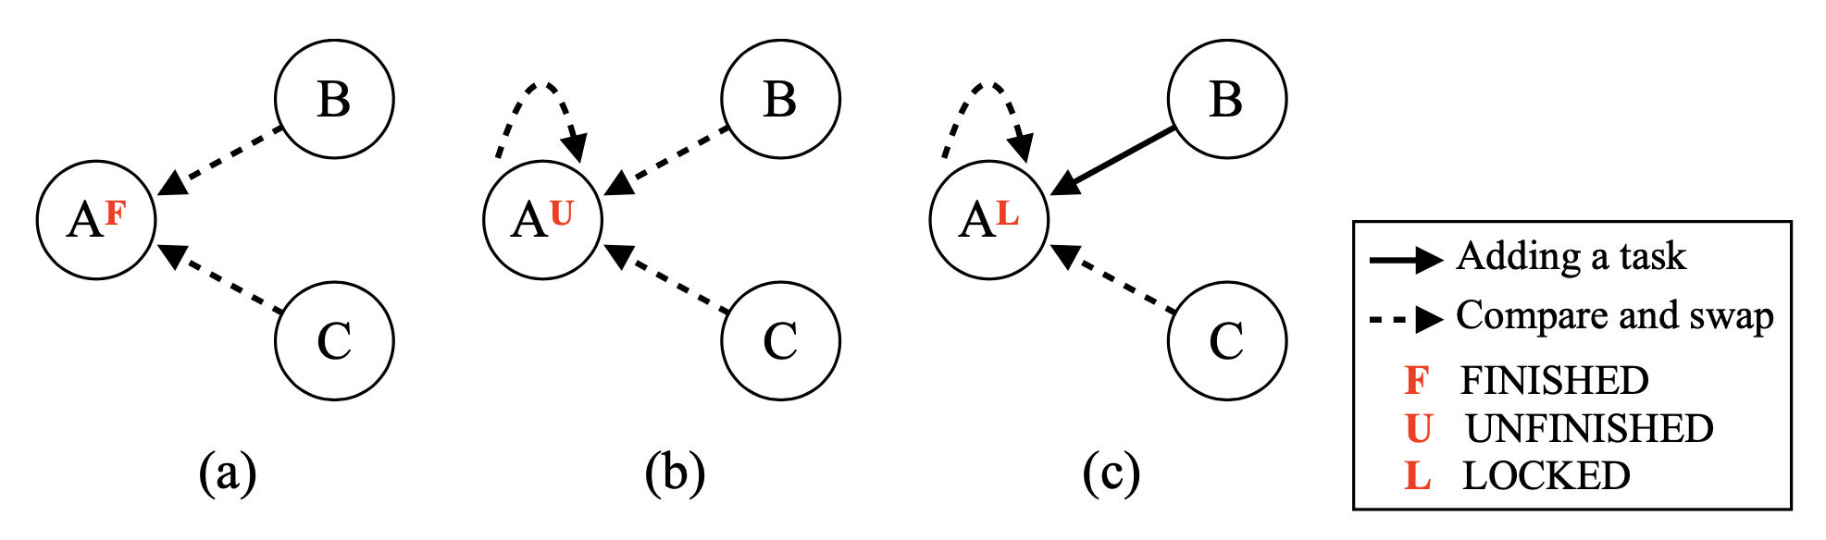
Solving Challenge #2: Data Race
Both B and C want to add themselves to the successors of A
Meanwhile, A may want to remove some of its successor when the task finishes
Use compare-and-swap (CAS) with spinning to enable exclusive access
Spinning does not incur much overhead because most task graphs are sparse
If you task graph is very dense, probably DTGP is not the right solution to your application
Notes:
The next challenge is data race because multiple threads may simultaneously access the successors of a task.
In this example, both B and C want to add themselves to the successors of A. Meanwhile, A may also want to remove its successors when it finishes.
A very simple solution, of course, is to use mutex to enable exclusive access, but mutex is very pricy especially when you have many dependencies on a task.
Instead, we use compare-and-swap (CAS) operation with spinning to enable exclusive access. This spinning does not incur much overhead as most task graphs in real world are sparse. If you task graph is very dense, probably DTGP is not the right solution to your application…

Slide 34
Solving Challenge #3: Synchronization
Users can issue both coarse- and fine-grained synchronizations at any time
Coarse-grained sync: executor.wait_for_all()
Fine-grained sync: future.wait()
// lock-based sync
std::unique_lock lock(mtx);
cv.wait(lock, [&](){
return num_tasks == 0;
});
tf::Executor executor;
auto A = executor.silent_dependent_async([]{});
auto B = executor.silent_dependent_async([]{}, A);
executor.wait_for_all(); // wait for A and B
auto C = executor.silent_dependent_async([]{}, A);
auto D = executor.silent_dependent_async([]{}, B, C);
executor.wait_for_all(); // wait for C and D
// atomic wait-based sync
auto n = num_tasks.load();
while(n != 0) {
num_tasks.wait(n);
n = num_tasks.load();
});
We leverage C++20 atomic variables to perform waiting/notifying operations¹, which allows much of the synchronization to occur in user space rather than in the kernel space (~11% performance improvement).
¹: C++20 atomic wait and notification: https://en.cppreference.com/w/cpp/atomic/atomic/wait
Notes:
The final challenge is synchronization. Users can issue both coarse- and fine-grained synchronizations at any time, such as waiting for the entire graph to finish or waiting for a particular subgraph to finish.
To synchronize the execution, one simple solution is to use a mutex plus a condition variable to notify the application when the condition is satisfied, like the number of tasks becomes zero. However, this lock-based solution can be expensive when the number of tasks and the number of threads become large.
(click) To reduce synchronization overhead, we leverage C++20 atomic variables to perform waiting/notifying operations, which allows much of the synchronization to happen in user space rather than in the kernel.

Slide 35
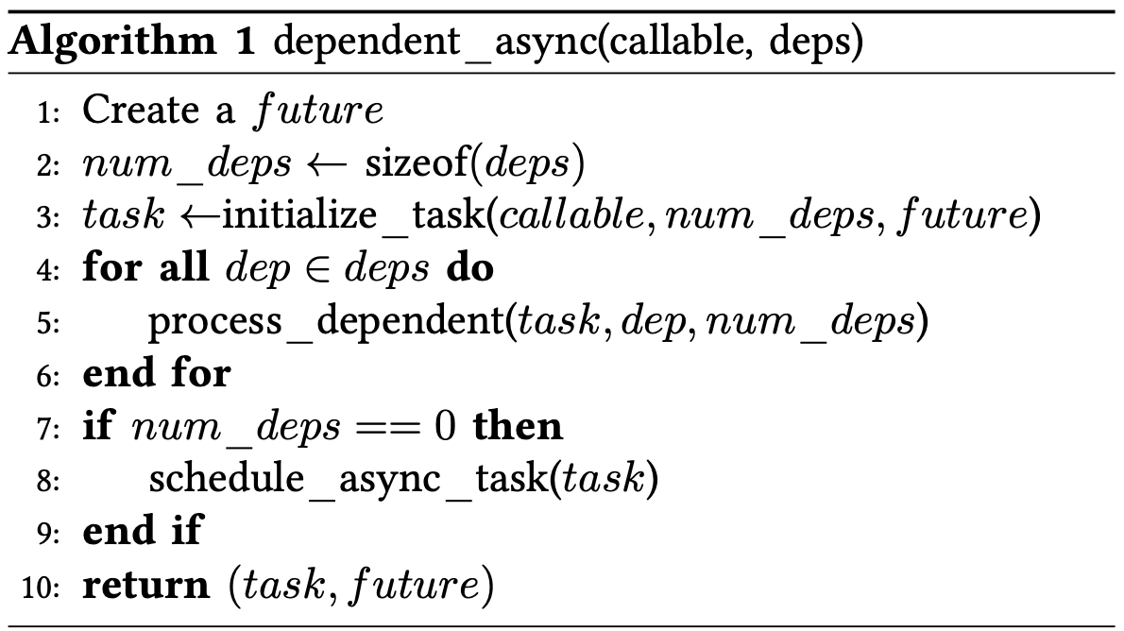
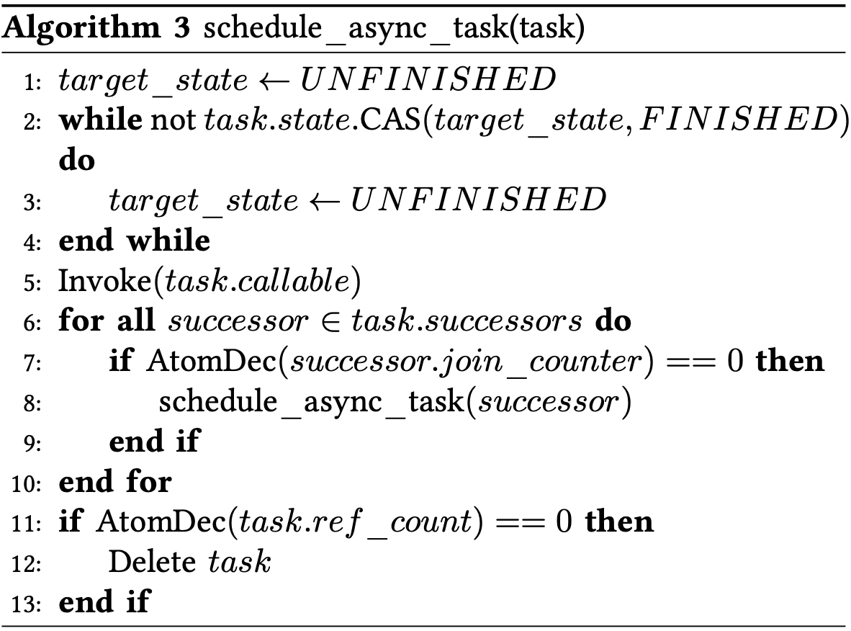
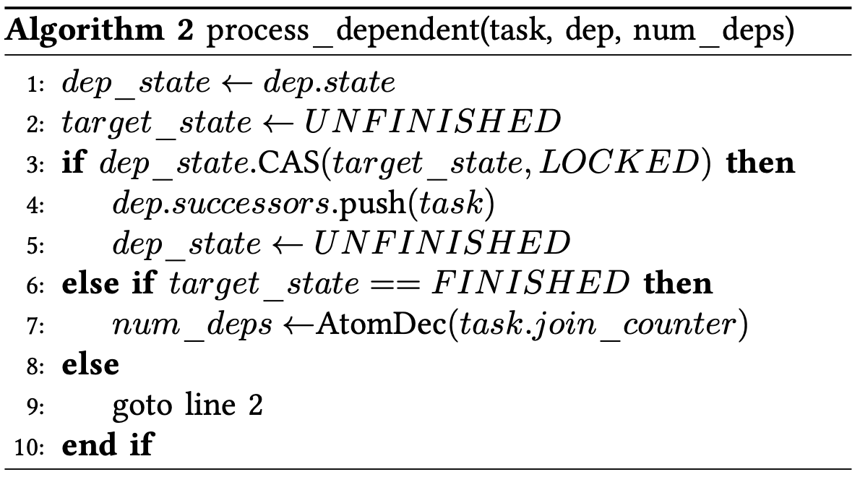
Our Scheduling Algorithm is Lock-free¹
¹: Cheng-Hsiang Chiu, et. al, “Programming Dynamic Task Parallelism for Heterogeneous EDA Algorithms,” IEEE/ACM ICCAD, 2023
Notes:
With all these ideas, our scheduling algorithm is completely lock-free. There is no mutex involved, of course, with C++20.
We have published this algorithm in ICCAD 2023, and I encourage you to check out the paper for more details.

Slide 36
Takeaways
Understand the importance of asynchronous tasking with dependencies
Recognize the limitations of existing asynchronous tasking models
Introduce a new dynamic task graph programming model called AsyncTask
Overcome the scheduling challenges to support the model
Demonstrate the efficiency of AsyncTask
Conclude the talk
Notes:
Now, I am going to demonstrate the efficiency of AsyncTask.

Slide 37
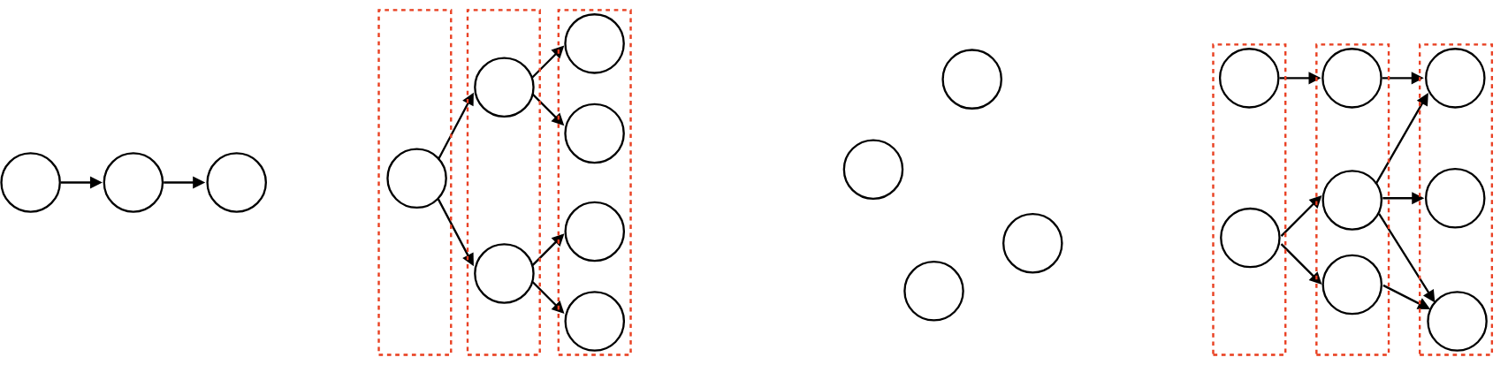
Evaluation of AsyncTask (1/2)
Evaluated on both microbenchmarks and a real-world application
Study the performance of AsyncTask w/o and w/ the impact of application tasks
Microbenchmarks
Measure the performance on four commonly used graph patterns
Real-world application: VLSI Static Timing Analysis¹
Parallelize the timing propagation algorithm using AsyncTask
Linear chain
Binary tree
No deps
Random G
Propagation task graph
¹: Tsung-Wei Huang, et al, “OpenTimer v2: A New Parallel Incremental Timing Analysis Engine,” IEEE TCAD, 2022
Notes:
We evaluate the performance of AsyncTask on both microbenchmarks and a real-world application to study its performance w/o and w/ the impact of application tasks.
In terms of microbenchmarks, we measure the performance on four commonly used task graph patterns:
In Linear chain, tasks are executed sequentially, one after another.
In Binary tree, each task spawns two dependent tasks,
In Embarrassing parallelism, all tasks are independent and can run simultaneously without any dependencies.
In Random graph, tasks have dependencies assigned arbitrarily, representing irregular workloads.
In terms of the real-world application, we use AsyncTask to implement a task-parallel static timing analysis application in VLSI where we parallelize the timing propagation algorithm using AsyncTask.

Slide 38
Evaluation of AsyncTask (2/2)
We consider the following baselines:
OpenMP tasking: https://www.openmp.org/spec-html/5.0/openmpsu99.html
PaRSEC: https://github.com/ICLDisco/parsec
OpenCilk: https://github.com/opencilk
AsyncTask^{LK}: replaced AsyncTask’s scheduler with OpenMP’s task scheduler¹
We want to see how good our lock-free scheduling algorithm is
AsyncTask^{CV}: replaced AsyncTask’s atomic wait with std::condition_variable
We want to see how good our C++20-based notification algorithm is
We compiled all programs using g++12 with –std=c++20 and –O3
64-bit Linux machine with 128 GB RAM and 20 Intel i5-13500 CPU cores at 4.8 GHz
All data is an average of ten runs to reduce variance
¹: OpenMP task graph scheduler leverages a lock-based hash table to keep track of tasks and their dependency handles
Notes:
We consider the following baselines, OpenMP Tasking, PaRSEC, OpenCilk, and AsyncTask LK and AsyncTask CV.
AsyncTask LK replaced our scheduler with OpenMP’s task scheduler, which leverages a lock-based hash table to keep track of tasks and their dependency handles. This comparison allows us to measure how good our lock-free scheduling algorithm is.
AsyncTask CV replaced our atomic variable-based notification algorithm with condition variable. This comparison allows us to see how good our C++20 notification algorithm is.
All programs are compiled using G++12 with C++20 standard enabled and optimization flag O3.
The machine we tested is a 64-bit linux machine with 128 GB RAM and 20 Intel i5 cores each at 4.8 GHz. All data is an average of ten runs.

Slide 39
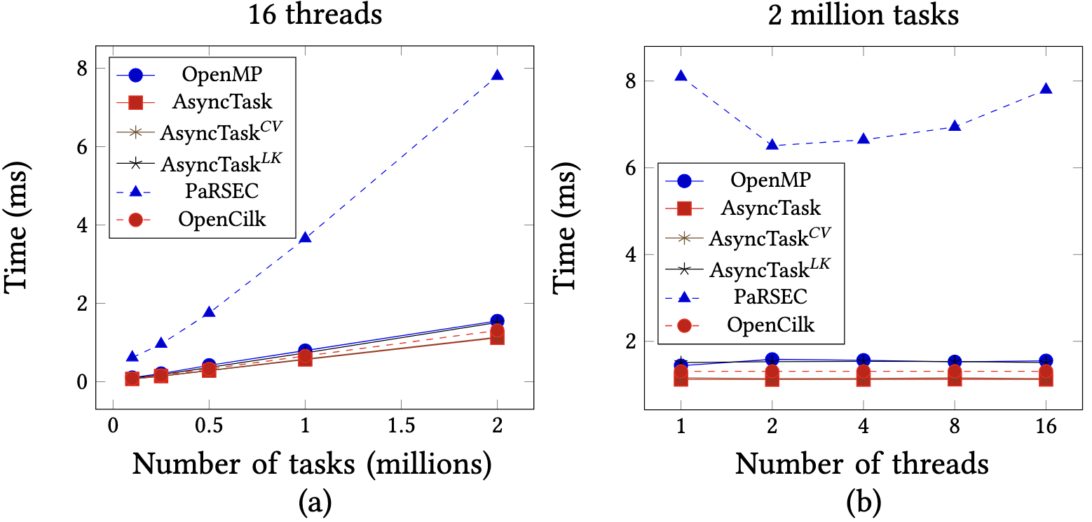
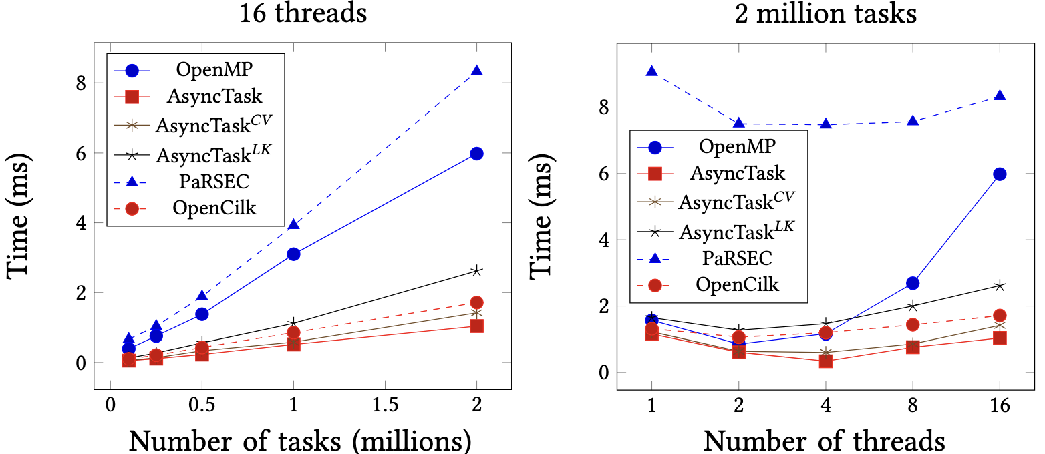
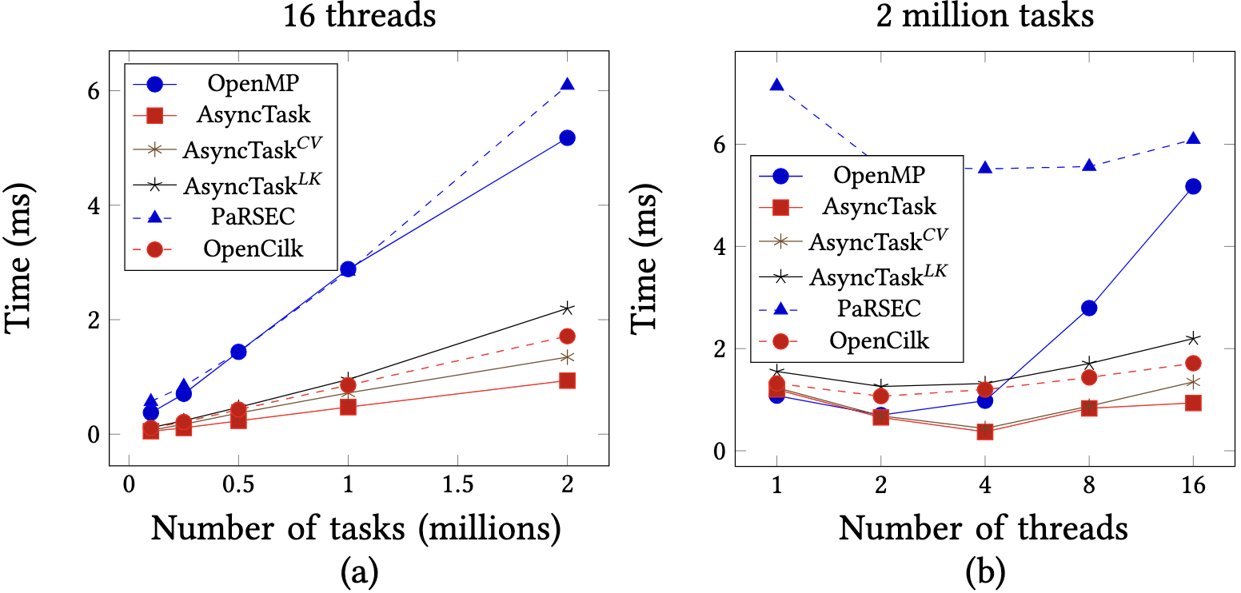
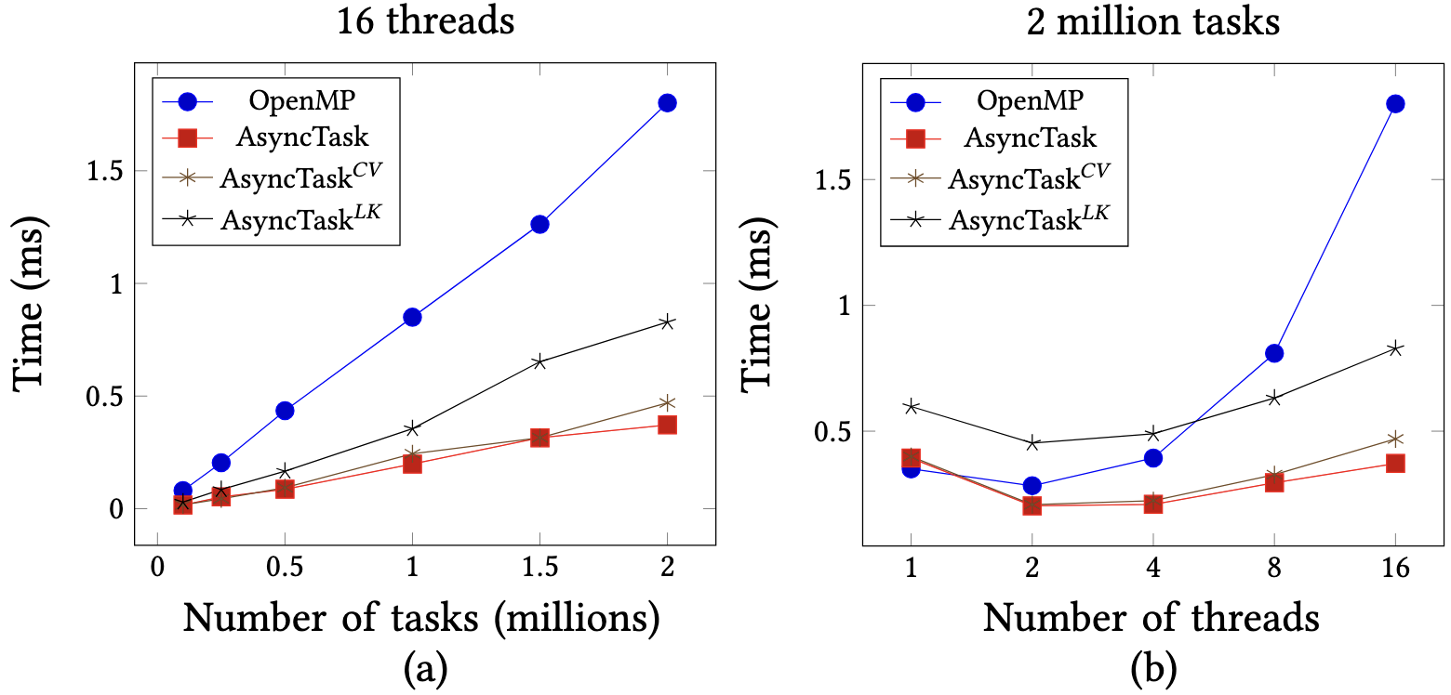
Microbenchmarks
Linear chain
Binary tree
No deps
Random G
Notes:
This slide plots the performance comparison for the four microbenchmarks, linear chain, binary tree, embarrassing parallelism, and random graph.
In general, AsyncTask is doing a very good job, outperforming baselines in nearly all scenarios.
For example, in random graph, as we increase the number of tasks, AsyncTask scales much better than the other baselines, and the gap to OpenMP continues to enlarge.
For a fixed graph of 2M tasks, runtime decreases as the number of threads increases and saturates at about 4 threads. Of course, this depends on the maximum parallelism available in the task graph.
Similar trend can also be observed in the other three microbenchmarks.

Slide 40
Ease of Use of AsyncTask
Surveyed 300+ graduate students in my HPC course at UW-Madison
Asked students to finish four microbenchmarks using five DTGP models
Rated each library in 1–10 (the higher the better) by the end of this programming assignment
Most students can complete the assignments using AsyncTask and std::async
Most students have hard time programming the random graph especially using OpenMP
Notes:
We also measured the ease of use of AsyncTask by surveying over 300 graduate students in my HPC courses at UW-Madison.
I took advantage of me teaching the high-performance computing and designed a programming assignment asking students to complete these microbenchmarks using five different DTGP libraries, AsyncTask, OpenMP, OpenCilk, PaRSEC, and std::async. By the end of this assignment, I asked students to rate each library in a score of 1-10 (the higher the better).
Here is the result of this survey: Most students find AsyncTask, OpenMP, OpenCilk and std::async very easy to learn, and they can complete most programs with AsyncTask and std::async.
Debugging is a little bit disappointed, but students still found AsyncTask the easiest to debug because the expression of tasks and their dependencies are not decoupled from each other.
In terms of correctness, most students have hard time using existing libraries but AsyncTask to complete the random graph benchmark. Especially for OpenMP, over 90% of the students cannot get it right.

Slide 41
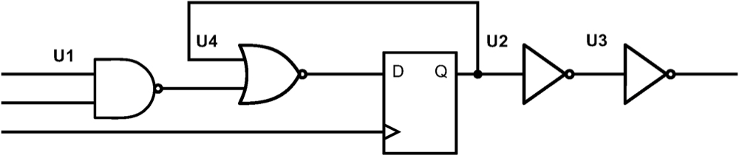
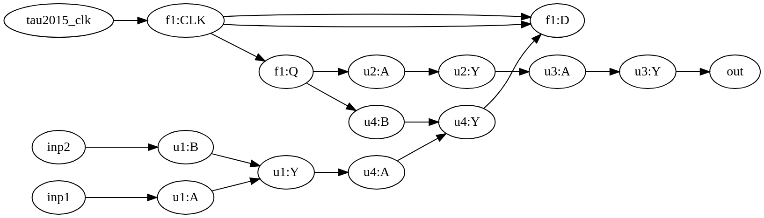
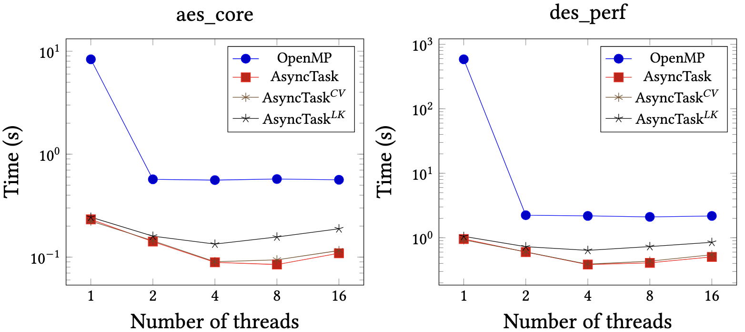
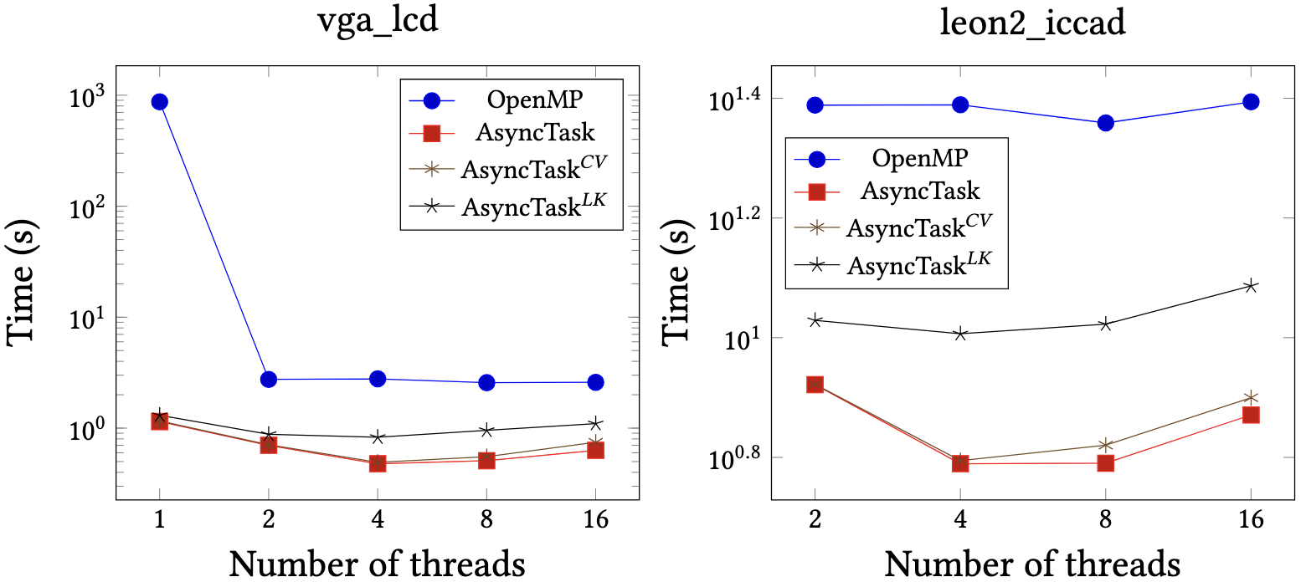
Real-world Application: Static Timing Analysis (STA)
Implemented task-parallel STA¹ using AsyncTask
Models the timing propagation as a dynamic task graph
Propagates timing data from inputs to outputs
Evaluated on four industrial circuit graphs
aes_core: 66,751 tasks and 86,446 dependencies
des_perf: 303,690 tasks and 387,291 dependencies
vga_lcd: 397,809 tasks and 498,863 dependencies
leon2: 4,328,255 tasks and 7,984,262 dependencies
¹: Tsung-Wei Huang, et al, “OpenTimer v2: A New Parallel Incremental Timing Analysis Engine,” IEEE TCAD, 2022
Notes:
Now I am going to talk about the evaluation on a real-world application, static timing analysis or STA, which verifies timing behaviors of your circuits.
We implemented the task-parallel STA algorithm using AsyncTask, where the timing propagation is modeled as a dynamic task graph, propagating the timing data from the inputs to the outputs of the circuit. For example, here I have the task graph representing the timing propagation of this simple circuit.
We evaluated the performance on four industrial circuit graphs, aes_core, des_perf, vga_lcd, and leon2. The largest graph has over 4M tasks and about 8M dependencies.
As you can see from the plot, AsyncTask always outperforms the baselines. Regardless of the number of threads we used to run the task graph, there is consistent gap between AsyncTask and others.
This result highlights the efficiency of our scheduling algorithm.

Slide 42
Runtime Comparison: STGP¹ vs DTGP
In STGP, building the task graph is typically done in just one thread and does not overlap with the task graph execution
However, when graphs are small, the scheduling overhead of DTGP outweighs this overlap advantage
¹: T.-W. Huang, et. al, “Taskflow: A Lightweight Parallel and Heterogeneous Task Graph Computing System,” IEEE TPDS, 2022
Notes:
We also compared the performance with STGP implemented using Taskflow. The purpose of this experiment is to highlight the advantages of DGTP, especially for large task graphs where overlapping task graph construction and execution can provide a big performance advantage.
(click) In STGP, building the task graph is typically done in just one thread and does not overlap with the task graph execution. For large graph like vga_lcd, which has about 400K tasks and dependencies, the time we spent on constructing the graph is non-negligible, taking almost 15%. In this case, DTGP will be faster than STGP.
(click) Obviously, when graphs are small, the scheduling overhead of DTGP outweighs this overlap advantage.

Slide 43
Takeaways
Understand the importance of asynchronous tasking with dependencies
Recognize the limitations of existing asynchronous tasking models
Introduce a new dynamic task graph programming model called AsyncTask
Overcome the scheduling challenges to support the model
Demonstrate the efficiency of AsyncTask
Conclude the talk
Notes:
In today’s talk, we have understood the importance of asynchronous tasking with dependencies and went through several limitations of existing asynchronous tasking models.
Then, we have introduced a new dynamic task graph programming model called AsyncTask and showcase how we overcome some of the important scheduling challenges to support the model.
Finally, we have demonstrated the efficiency of AsyncTask on both microbenchmarks and a real-world application.

Slide 44
Everything has been Integrated to Taskflow¹
Taskflow is a header-only C++ library for task-parallel programming
Started in 2018 to help DARPA parallelize critical design automation workloads
Using AsyncTask is very easy
# clone the Taskflow project
~$ git clone https://github.com/taskflow/taskflow.git
~$ cd taskflow
# compile your program and tell your compiler where to find Taskflow header files
~$ g++ -std=c++20 examples/simple.cpp –I ./ -O2 -pthread -o simple
~$ ./simple
TaskA
TaskC
TaskB
TaskD
¹: Taskflow: A General-purpose Task-parallel Programming system in Modern C++: https://taskflow.github.io/
Notes:
Everything we discussed today about AsyncTask has been integrated to Taskflow.
In case you don’t know, Taskflow is header-only C++ library for task-parallel programming. The project started in 2018 to help DARPA parallelize critical design automation workloads that cannot be efficiently handled by existing models.
Using AsyncTask is very easy, you simply need to download the taskflow project and compile your program by telling your compiler where to find taskflow header files.
That’s it. No wrangling with installation.

Slide 45

Thank you for using Taskflow!
…
Notes:
Finally, I would like to say thank you to all the users who are using Taskflow in their projects. Taskflow is open-source and is being used by a growing number of people from both academia and industry.
We are always happy to collaborate!

Slide 46






Thank you for Sponsoring Taskflow!
Notes:
The project will not be successful without the sponsors. We really appreciate the financial support.

Slide 47
Questions?
Taskflow: https://taskflow.github.io
Static task graph parallelism
Dynamic task graph parallelism
// Live: https://godbolt.org/z/j8hx3xnnx
tf::Taskflow taskflow;
tf::Executor executor;
auto [A, B, C, D] = taskflow.emplace(
[](){ std::cout << "TaskA\n"; }
[](){ std::cout << "TaskB\n"; },
[](){ std::cout << "TaskC\n"; },
[](){ std::cout << "TaskD\n"; }
);
A.precede(B, C);
D.succeed(B, C);
executor.run(taskflow).wait();
// Live: https://godbolt.org/z/T87PrTarx
tf::Executor executor;
auto A = executor.silent_dependent_async([]{
std::cout << "TaskA\n";
});
auto B = executor.silent_dependent_async([]{
std::cout << "TaskB\n";
}, A);
auto C = executor.silent_dependent_async([]{
std::cout << "TaskC\n";
}, A);
auto D = executor.silent_dependent_async([]{
std::cout << "TaskD\n";
}, B, C);
executor.wait_for_all();
T.-W. Huang, et. al, “Taskflow: A Lightweight Parallel and Heterogeneous Task Graph Computing System,” IEEE TPDS, 2022
Notes:
With that, I am going to stop here. I will be happy to take any questions.

